Slide 1
PowerPoint Shortcuts & Formatting Tricks
Convert Data into Infographic Visuals
Content Creator (Joint): YodaLearning.com / ExcelSuperStar.org

Slide 2
9 most important shortcuts of Power Point
1 | Keep <SHIFT> pressed and then draw/resize Shapes*** | Symmetrical drawing/resizing
2 | Keep <SHIFT> <CTRL> pressed & then drag objects | Create instant replicas with alignment
3 | CTRL + Y or F4 | Repeat last action
4 | CTRL + G & CTRL + SHIFT + G | Group and Ungroup selected Objects
5 | ALT ← → | Rotate in 15° increments
6 | CTRL D | Creates a duplicate of the selected Object
7 | Ctrl Shift C and Ctrl Shift V | Copy and Paste format (shapes, text)
8 | Ctrl Shift > vs. Ctrl Shift < | Text Size Increase vs. Decrease
9 | Ctr R vs. Ctrl L vs. Ctrl E | Text Alignment (Right – Left – Center)
*** helps keep the lines straight

Slide 3


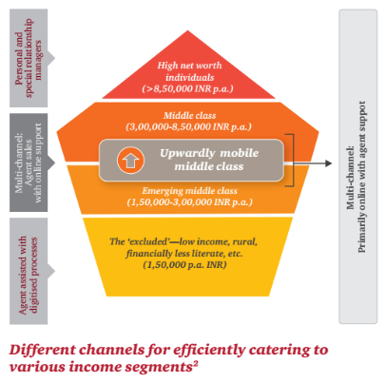
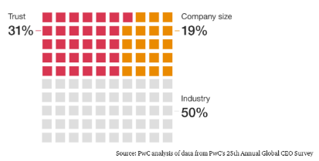
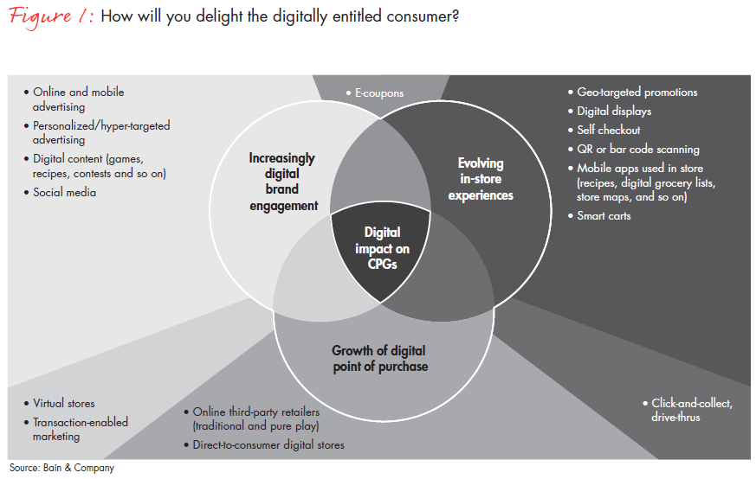
Visual Infographics from our competition’s websites -
Source: PwC Report – Rethinking Distribution Smart Solutions for Smart Customers
Source: www.pwc.com/us/en/industries/energy-utilities-resources/power-utilities/utility-platform-player.html
Source: www.pwc.com/us/en/services/consulting/cybersecurity-risk-regulatory/library/global-crisis-survey.html
Source: Bain

Slide 4

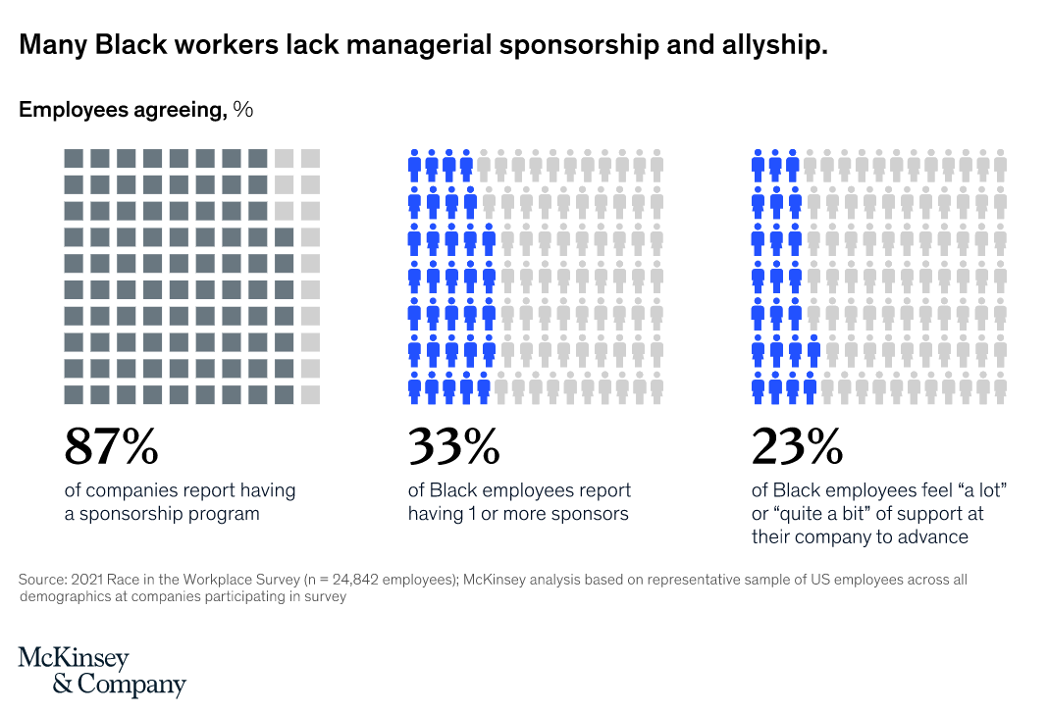
Visual Infographics from our competition’s websites -
[Shift + Ctrl] keys pressed + Hold down the object -> drag-out with the Mouse
Ctrl Y
Others: Group, UnGroup, Rotate, Shift to Resize

Slide 5
Some essentials -

Slide 6
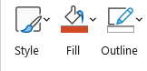
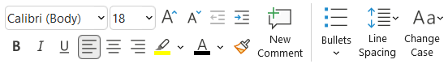
Basics - of Shape & Text Formatting
Shapes - Color, Transparency, Outline (Weight, Dashes), Resize; Shape Effect; Edit Text
Text - Color, Size, Change Case

Slide 7

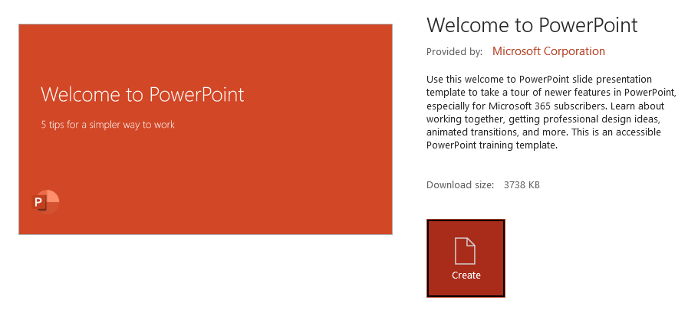
Basics of - PowerPoint’s Color Picker tool = Eyedropper
No more hard-coding RGB colors – v. 2013+

Slide 8

Using Smart Guides to align shapes
Smart Guides in 2010+ = View tab -> Show

Slide 9
Let’s start now -

Slide 10
Speed shortcuts for process flow diagrams & formatting
1 | Keep <SHIFT> pressed and then draw/resize Shapes*** | Symmetrical drawing/resizing
2 | Keep <SHIFT> <CTRL> pressed & then drag objects | Create instant replicas with alignment
3 | CTRL + Y or F4 | Repeat last action
4 | CTRL + G & CTRL + SHIFT + G | Group and Ungroup selected Objects
5 | ALT ← → | Rotate in 15° increments
6 | CTRL D | Creates a duplicate of the selected Object
7 | Ctrl Shift C and Ctrl Shift V | Copy and Paste format (shapes, text)
8 | Ctrl Shift > vs. Ctrl Shift < | Text Size Increase vs. Decrease
9 | Ctr R vs. Ctrl L vs. Ctrl E | Text Alignment (Right – Left – Center)
*** helps keep the lines straight

Slide 11

Draw a perfect circle or a square or a straight line
Keep SHIFT key pressed
Applies to Re-sizing shapes & picture
Symmetry applies to straight lines too

Slide 12
Rotate objects with speed and precision
Alt and arrow keys

Slide 13

Rotate objects with speed and precision (…cont’d)
Alt and arrow keys

Slide 14
Why Group & Ungroup Objects
Ctrl G and Ctrl Shift G
Try to resize using Shift – with and without Grouping

Slide 15
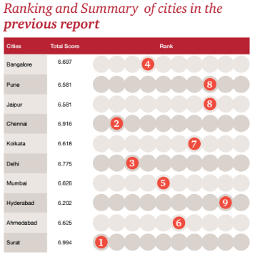
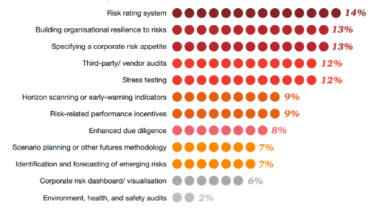
How to create auto-aligned duplicates
Ctrl D vs. Ctrl C and Ctrl V
[Shift + Ctrl] keys pressed -> Hold down the object -> drag-out with the Mouse -> Ctrl Y
Use above without Shift key
Source: PwC Report – How smart are our cities
Source: PwC Report (pwc-2017-risk-in-review-study)

Slide 16


How to create auto-aligned duplicates (…cont’d)
[Shift + Ctrl] keys pressed -> Hold down the object -> drag-out with the Mouse -> Ctrl Y
1
2

Slide 17
Application: Advanced Visuals - Waffle Chart
[Shift + Ctrl] keys pressed + Hold down the object -> drag-out with the Mouse
Ctrl Y
Others: Group, UnGroup, Rotate, Shift to Resize

Slide 18

Convert data & stats into visually appealing infographics
Source: www.pwc.com/us/en/services/consulting/cybersecurity-risk-regulatory/library/global-crisis-survey.html
Source: www.pwc.com/us/en/industries/energy-utilities-resources/power-utilities/utility-platform-player.html

Slide 19
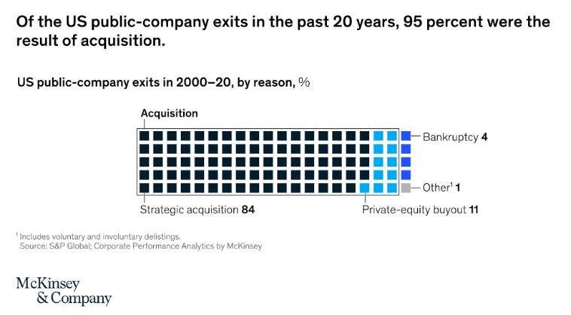
Application: Advanced Visuals - Waffle Chart

Slide 20
Practice area

Slide 21
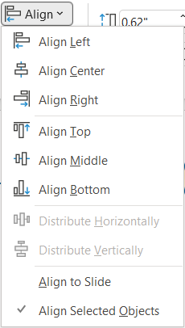
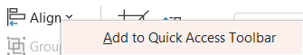
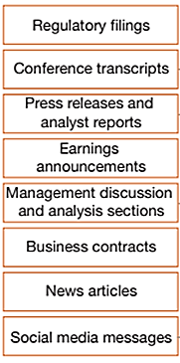
How to align objects lightning fast using QAT
QAT means Quick Access Toolbar
Source: PwC
Knowledge of Grouping (Ctrl G) will help

Slide 22
How to align objects lightning fast using QAT (…cont’d)
QAT means Quick Access Toolbar
A
2
1
3
6
B
4
5
C
D
E

Slide 23
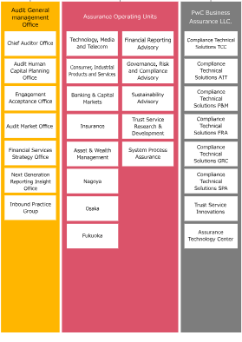
Convert data & stats into visually appealing infographics
Source: www.pwc.com/jp/en/about/member/assurance/organization.html

Slide 24
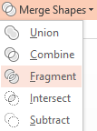
Create NEW shapes using Merge Shapes feature
Version 2013+

Slide 25
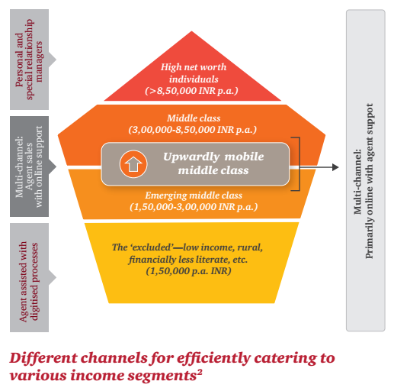

Create NEW shapes using Merge Shapes feature (…cont’d)
Use cases with examples from the industry:
Source: PwC Report – Rethinking Distribution Smart Solutions for Smart Customers
Source: McKinsey & Co.

Slide 26
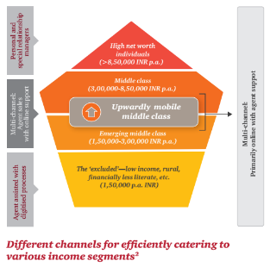

Create NEW shapes using Merge Shapes feature (…cont’d)
Practice area:
Source: PwC Report – Rethinking Distribution Smart Solutions for Smart Customers
Source: McKinsey & Co.

Slide 27
How to use Format Painter with a shortcut
Ctrl Shift C and Ctrl Shift V
1
2
3
X
Y
3
3
3
One-at-a-time formatting
Multiple times to-n-fro

Slide 28
Text Formatting – 1 (shortcuts)
Alignment = Ctrl [l, r, e, j]
Font Size Change = Ctrl Shift >
As information grows (in both access and volume) and Indian consumers and businesses are more able to apply this information in their decision making, they become more empowered.

Slide 29
ANNEXURE -

Slide 30
Video Links for PowerPoint:
3 ways to make creative shapes in PPT
Video Link (#shorts): https://youtu.be/l0X0gbuEyOw
Create a Waffle Infographics in PowerPoint 15 Seconds
Video Link (#shorts): https://youtu.be/2USHV88b7Xw
Essential shortcuts & their use cases
Create aligned duplicates
Lock Drawing Mode
Magnifier effect
Group and UnGroup
Alignment with QAT Shortcut
Video Link: https://youtu.be/WqzT68RsZg4
Our YouTube Channels:
ENG: https://www.youtube.com/c/Yodalearning/videos
HIN: https://www.youtube.com/c/ExcelSuperstar/videos

Slide 31


Overview – Slide Master
What is Slide Master
How to use it to create Templates (Text Properties, Design, Footer positions)
How to switch a slide to another layout

Slide 32
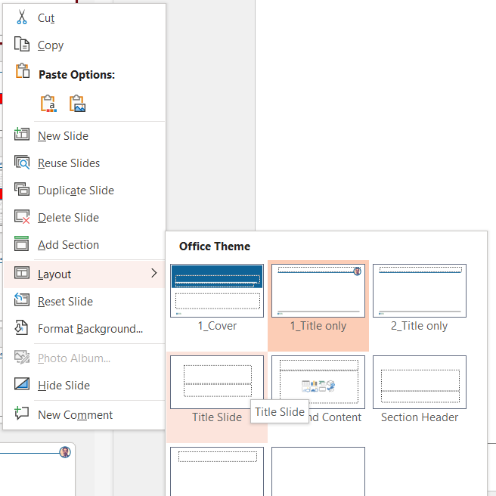
Overview – Slide Master
What is Slide Master
How to use it to create Templates (Text Properties, Design, Footer positions)
How to switch a slide to another layout

Slide 33

Ungroup a SmartArt
Ctrl Shift G - twice

Slide 34



Layering Images
Bring to Front / Bring Forward
Send to Back / Send Backward

Slide 35
Convert boring text paragraphs to SmartArt in 3 steps
Select text -> Right-click -> Convert to SmartArt
SmartArt Design tab
Three economic-growth scenarios
Scenario 1
As information grows (in both access and volume) and Indian consumers and businesses are more able to apply this information in their decision making, they become more empowered. And with their increased empowerment, they’ll demand ever more value from the products and services they buy—including greater quality and convenience. Companies will need to rethink their business models and competitive strategies to profitably serve these customers.
Scenario 2
As information grows (in both access and volume) and Indian consumers and businesses are more able to apply this information in their decision making, they become more empowered. And with their increased empowerment, they’ll demand ever more value from the products and services they buy—including greater quality and convenience. Companies will need to rethink their business models and competitive strategies to profitably serve these customers.
Scenario 3
As information grows (in both access and volume) and Indian consumers and businesses are more able to apply this information in their decision making, they become more empowered. And with their increased empowerment, they’ll demand ever more value from the products and services they buy—including greater quality and convenience. Companies will need to rethink their business models and competitive strategies to profitably serve these customers.
Source: PwC India Website - PWC_future-of-india-the-winning-leap.pdf

Slide 36




Convert pictures to SmartArt in 3 steps
Picture Format tab -> Picture Layout

Slide 37

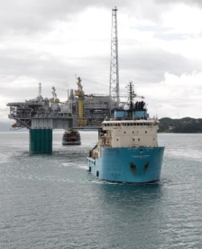
Convert pictures to SmartArt in 3 steps (…cont’d)
Picture Format tab -> Picture Layout
Source: Maersk Website – PDF report
Note: Such slide helps communicate to the client – “We understand your business”

Slide 38
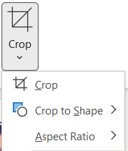




How to crop pictures
 Crop vs. Crop to Shape

Slide 39
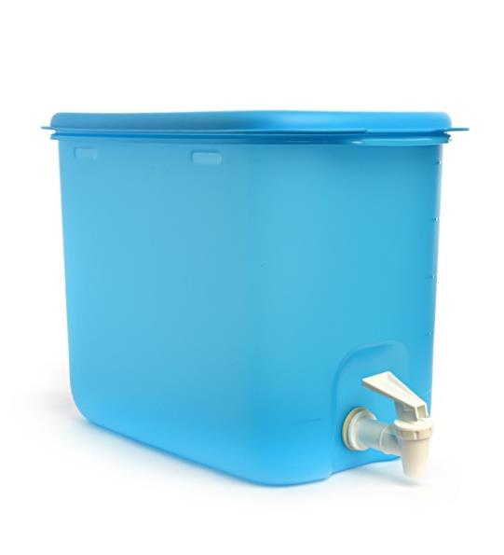
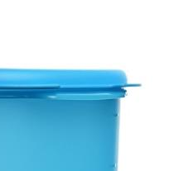
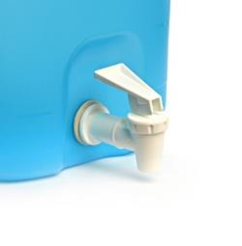
Create a Magnifier Effect
Applies to images -> Crop and Crop to Shape
Air-tight Lock
Single-push Dispenser

Slide 40
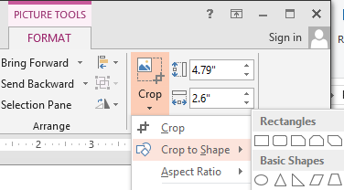
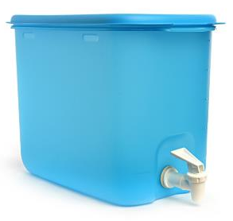
Create a Magnifier Effect (…cont’d)
Applies to images -> Crop and Crop to Shape
1
Ctrl + D
3
2

Slide 41
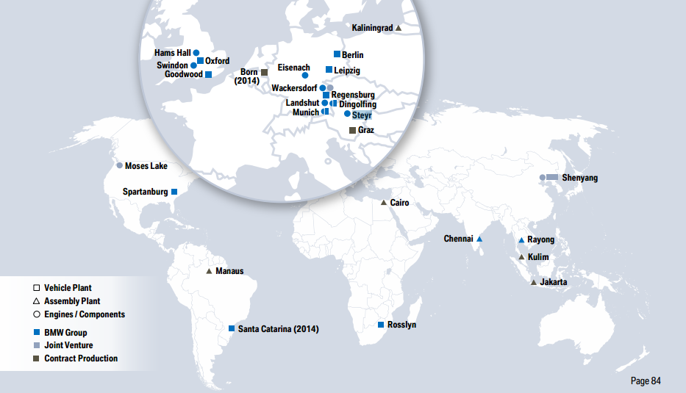
Create a Magnifier Effect (…cont’d)
Use cases with examples from the industry:
Location on a Map
Source: BMW_InvestorPresent_January_2014_online

Slide 42
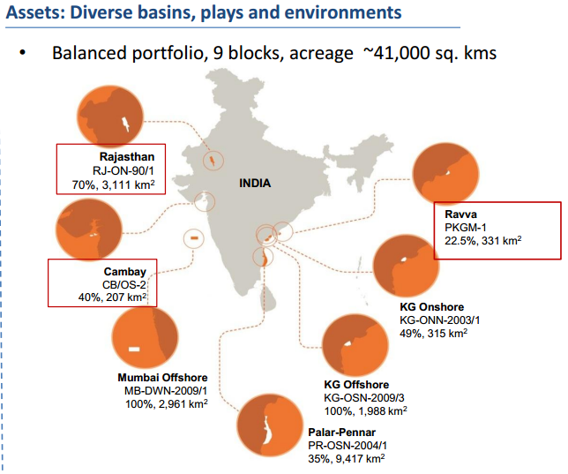
Create a Magnifier Effect (…cont’d)
Use cases with examples from the industry:
FYR: Focus on areas on a Map
Source: Cairn-India-Corporate-Presentation-August-2014

Slide 43
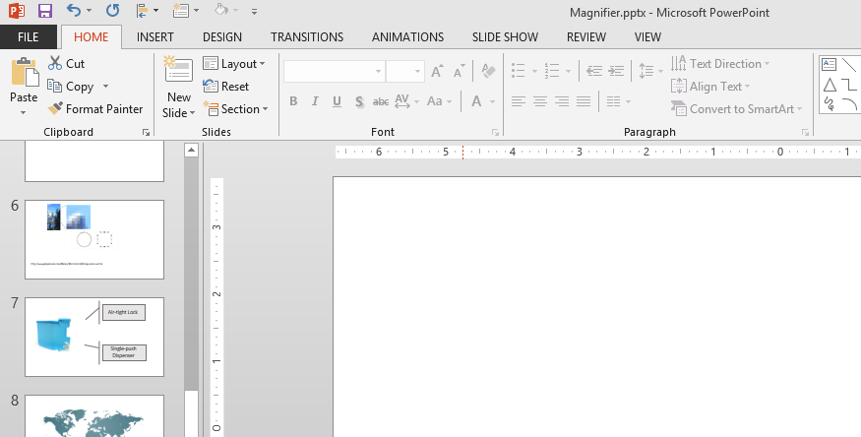
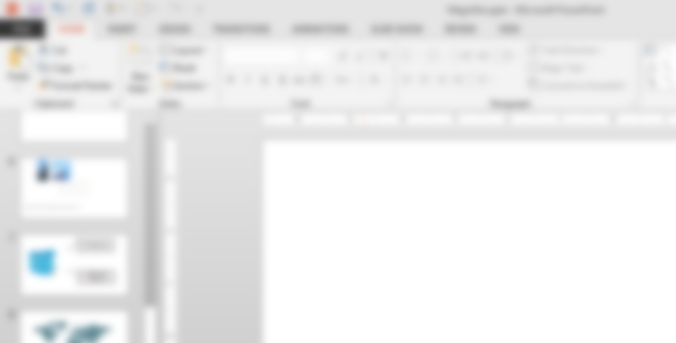
Create a Magnifier Effect (…cont’d)
Use cases with examples from the industry:
FYR: Create SOPs or Manuals
Source: BMW_InvestorPresent_January_2014_online

Slide 44

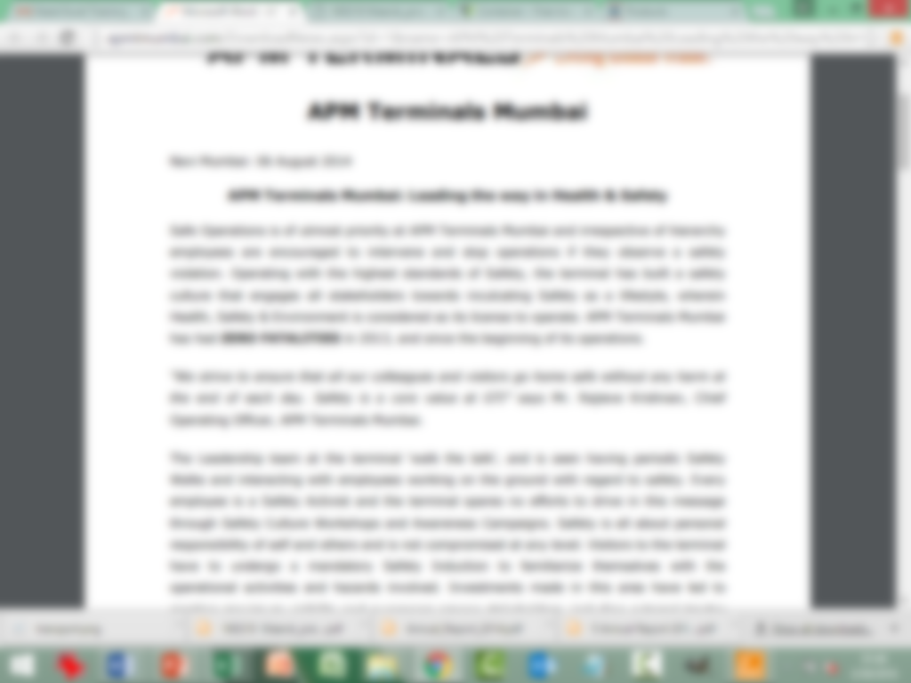
Create a Magnifier Effect (…cont’d)
Use cases with examples from the industry:
FYR: Focus on important T&C
Source: BMW_InvestorPresent_January_2014_online

Slide 45
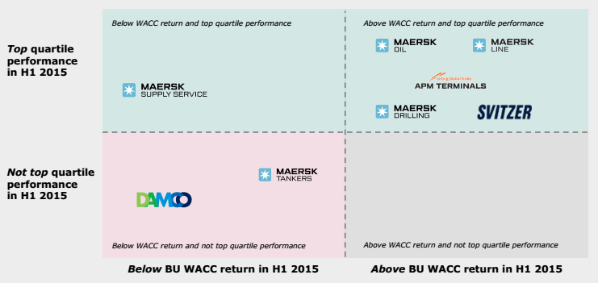

Removing simple background from an image
Picture Format tab -> Color -> Set Transparent Color
Source: Maersk Website – PDF report

Slide 46
End

